Slide 1
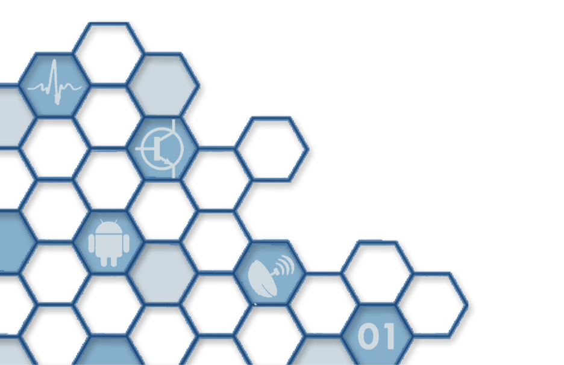
Writing and Publishing
Ranga Rodrigo

Slide 2
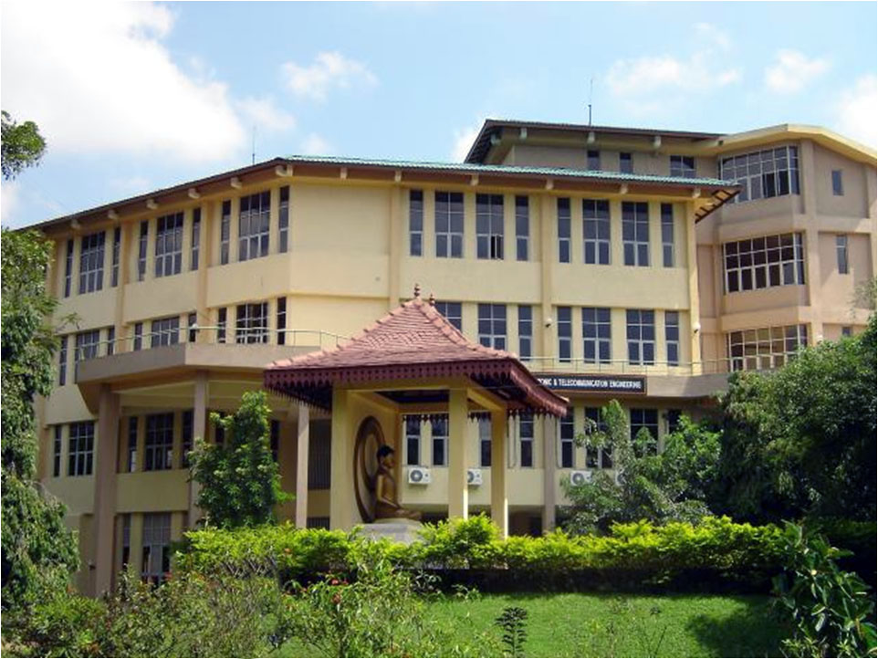

Slide 3
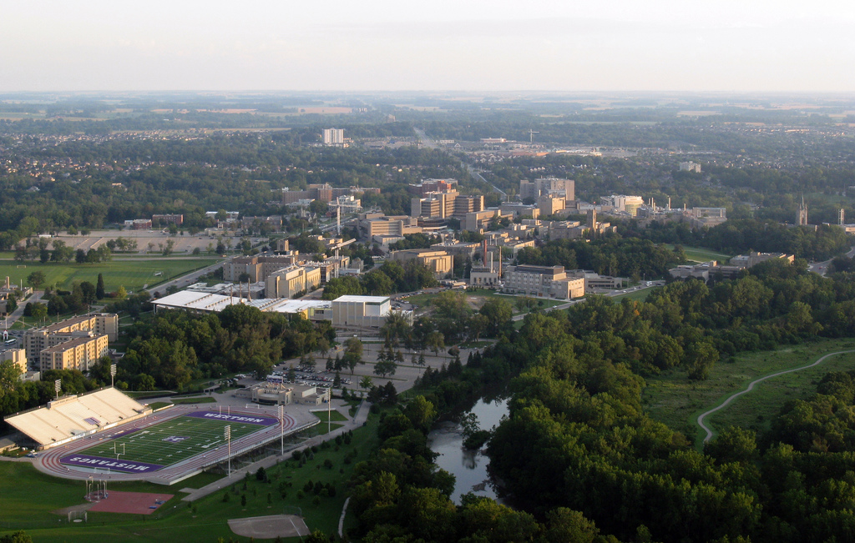

Slide 4
Contents
Research and publishing
Where to publish
Publication process
Peer review
Structure of an article
Writing style
Typographical software

Slide 5
What Is Research?
Searching through Google and finding out something that I or my colleagues do not know about (reinterpretation of old knowledge).
Finding out something that the world still does not know about (generating knowledge, originality).

Slide 6
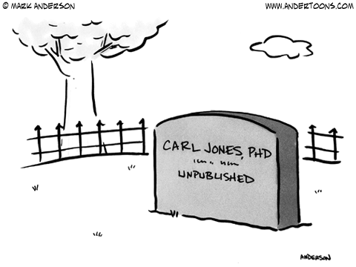
Notes:
Well, you discover paradigm-shifting, world-hunger-problem-solving something that the world does not know about, and just die! What happens to the something that your discovered?

Slide 7
Why Publish?
To enable others to replicate my work and put to good use.
Then write in a way so that others could understand and use!

Slide 8
Which Article Should You Write?
There are two possible articles you can write:
(a) the article you planned to write when you designed your study or
(b) the article that makes the most sense now that you have seen the results.
They are rarely the same.
The correct answer is (b).
Writing the Empirical Journal Article by Daryl J. Bem

Slide 9
Where to Publish

Slide 10
Where to Publish
Journals (transactions, letters)
Conferences
Book chapters
Monographs (thesis)
Internal technical report (tech-reports)
Manuals

Slide 11
Journals vs. Conferences
Journal
Conference
Frequent (monthly) issues
Comprehensive
Prestigious
Usually harder
12, double-column pages of tightly packed text
Free
Rebuttal possible
Quick dissemination of research
Seen to be easier, some are extremely hard
8 pages of double-column loosely packed text
Expensive (registration, travel, lodging)
No rebuttal

Slide 12
What is a Tech-Report
A scientific or technical report describes a research process or research and development results or the current state-of-the-art in a certain field of science or technology.
Types:
Reports about laboratory experiments
Construction and design reports
Reports about testing measurements
Various theses
Articles in a scientific journal
Project reports
Tech-Reports
Research Papers
Lutz Hering and Heike Hering 2010 p. 1

Slide 13
Science Citation Index
The Science Citation Index (SCI) is a citation index originally produced by the Institute for Scientific Information (ISI) and created by Eugene Garfield. It is now owned by Thomson Reuters.
The larger version (Science Citation Index Expanded) covers more than 6,500 notable and significant journals, across 150 disciplines, from 1900 to the present.
These are alternately described as the world's leading journals of science and technology, because of a rigorous selection process.
The index is made available online through the Web of Science database, a part of the Web of Knowledge collection of databases.
http://en.wikipedia.org/wiki/Science_Citation_Index

Slide 14
Impact Factor
The impact factor of a journal is a measure reflecting the average number of citations to recent articles published in the journal.
Calculation for journal impact factor:
A = total cites in 1992
B = 1992 cites to articles published in 1990-91 (this is a subset of A)
C = number of articles published in 1990-91
D = B/C = 1992 impact factor
http://en.wikipedia.org/wiki/Impact_factor, http://wokinfo.com/essays/impact-factor/

Slide 15
Some Impact Factors
Journal | Publisher | IF
IEEE Transactions on Pattern Analysis and Machine Intelligence | IEEE | 4.795
International Journal of Computer Vision | Springer | 3.623
IEEE Transactions on Image Processing | IEEE | 3.199
IEEE Transactions on Systems, Man, and Cybernetics, Part B: | IEEE | 3.236
Other Measures
Eigenfactor
Article influence score
h index
i10 index

Slide 16
Publication Process

Slide 17
Ok. Now you have made a discovery that the world does not still know about. You have decided to publish this. You have also made the initial write-up, and done the missing further research. You have identified a journal as well.
How should you go about having this published?

Slide 18
Write the Manuscript
Submit to the Journal
Editor Sends for Peer Review
Accept with revisions or rejected with encouragement to resubmit
Rejected with no encouragement to resubmit
Editor’s Decision
Re-Do Some Work, Thoroughly Revise
Thoroughly Revise
Accept
Revise
Submit Revised Paper
Submit Camera-Ready Paper
Submit as a Fresh Paper

Slide 19
Peer Review

Slide 20
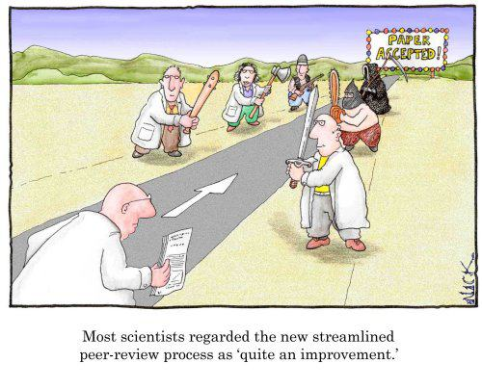
Peer-Review Process
http://www.justinholman.com/2012/03/24/academic-peer-review/

Slide 21
Editor Assigns the Submitting to an Associate Editor
Associate Editor Assigns Reviewers
Reviewers Review the Paper
Associate Editor Receives Reviews and Confidential Reviews
Associate Editor Makes the Decision to Accept or Reject
Editor Communicates the Decision

Slide 22
Peer-Review Types
Single-Blind Review
Reviewers are hidden from authors
Double-Blind Review:
Both reviewers and authors remain anonymous.
Open Review
Reviewer and author are known to each other.
Note: A conflict of interest arises when a reviewer and author have a disproportionate amount of respect or disrespect for each other.
http://www.elsevier.com/reviewers/peer-review, http://en.wikipedia.org/wiki/Peer_review

Slide 23
Review Criteria
Category (application, research, survey)
Correctness
Relevance (to the readers of the journal)
Readability
Originality
Contribution
Utility
Results and comparison
References

Slide 24
Writing: STRUCTURE

Slide 25
Criteria for Scientific Writing
Primary
Secondary
Accuracy
Clarity
Interesting
Style
The first step toward clarity is good organization
The second step toward clarity is to write simply and directly
Writing the Empirical Journal Article by Daryl J. Bem

Slide 26
Structure of an Article

Slide 27
Structure of an Article
Abstract
Introduction
Method
Results and Discussion
References
Conclusion

Slide 28
General-Specific-General
An article begins with broad general statements, progressively narrows the specifics of your study, and then broadens out again to more general considerations.
Writing the Empirical Journal Article by Daryl J. Bem

Slide 29
The introduction begins broadly: | “Individuals differ radically from one another in the degree to which they are willing and able to express their emotions.”
It becomes more specific: | “Indeed, the popular view is that such emotional expressiveness is a central difference between men and women.... But the research evidence is mixed...”
And more so: | “There is even some evidence that men may actually...”
Until you are ready to introduce your own study in conceptual terms: | “In this study, we recorded the emotional reactions of both men and women to filmed...”
The method and results sections are the most specific, the “neck” of the hourglass: | (Method) One hundred male and 100 female undergraduates were shown one of two movies...” “(Results) Table 1 shows that men in the father-watching condition cried significantly more...”
The discussion section begins with the implications of your study: | “These results imply that sex differences in emotional expressiveness are moderated by two kinds of variables...”
It becomes broader: | “Not since Charles Darwin’s first observations has psychology contributed as much new...”
And more so: | “If emotions can incarcerate us by hiding our complexity, at least their expression can liberate us by displaying our authenticity.”
Writing the Empirical Journal Article by Daryl J. Bem

Slide 30
Abstract
Introduction
Method
Results
Conclusion

Slide 31
Structure of a Thesis
Is it primarily different from the structure of an article?
No

Slide 32
Structure of a Thesis
Abstract
Title Page
Abstract
Table of Contents
List of Figures
List of Tables
Introduction
Literature Survey
Material and Methods
Results
Discussion
Conclusions
Acknowledgments
References
Appendices
Introduction
Method
Results and Discussion
Conclusion
References
http://www.ldeo.columbia.edu/~martins/sen_sem/thesis_org.html

Slide 33
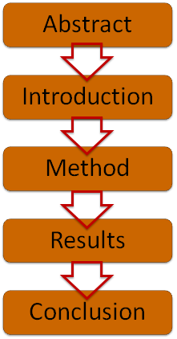
Abstract
An abstract is a brief summary of a research article, thesis, review, conference proceeding or any in-depth analysis of a particular subject or discipline, and is often used to help the reader quickly ascertain the paper's purpose.
Why is this important? Why should I read this?
http://en.wikipedia.org/wiki/Abstract_(summary)

Slide 34
Parts of an Abstract
Motivation
Problem statement
Approach
Contributions
Results
Conclusions
https://www.ece.cmu.edu/~koopman/essays/abstract.html

Slide 35
Introduction
Goal of the paper, motivation
Background information (significance and context)
Literature (separate section in thesis)
Proper acknowledgement
Only relevant
Provide backdrop
Roadmap

Slide 36
Methods
Establish credibility of your work
Information to replicate your work
Materials, procedure, theory
Limitations assumptions
Analytical and statistical methods

Slide 37
Results
Qualitative and quantitative
Statistics, graphs, tables
Comparison with recent, closely-related work

Slide 38
Discussion
Interpret results in the backdrop laid in the introduction and literature review
Patterns observed, relationships, trends, generalizations
Likely causes
Implications

Slide 39
Conclusions
What are the most important statements that you would make in retrospect of your work that would benefit your reader?
Brief summary in retrospect
Conclusions
Implications

Slide 40
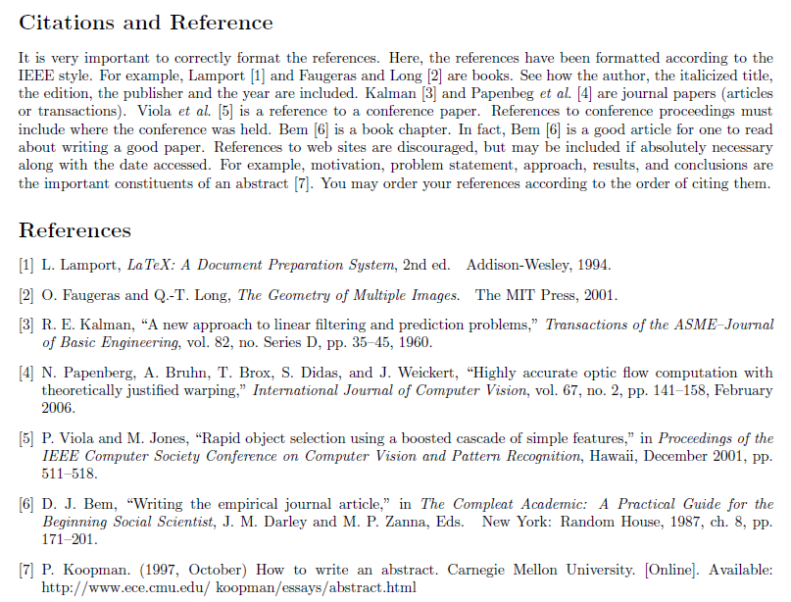
Citations and References

Slide 41
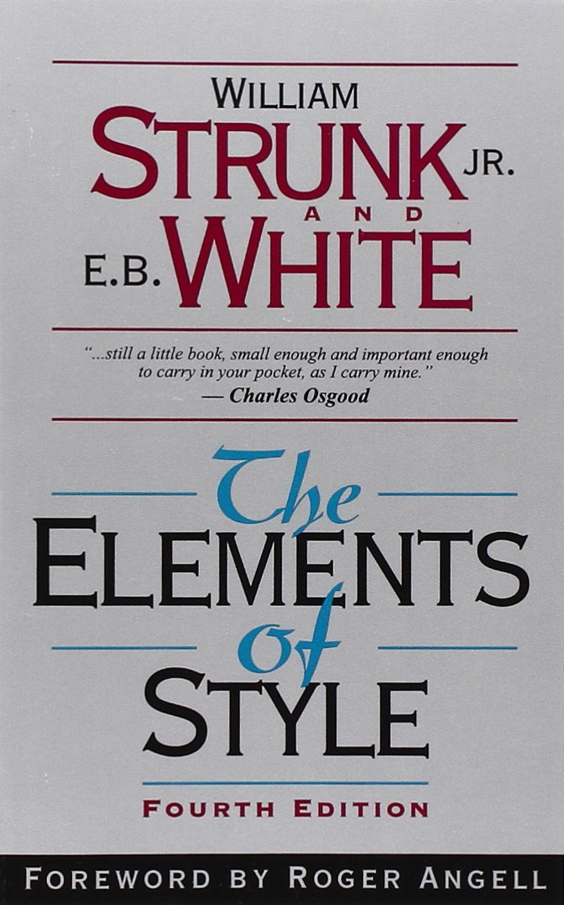
STYLE

Slide 42
12
Contrast: a love letter
Planning must be a deliberate prelude to writing.
Start from a skeleton.
Then fill in the text.
Choose a suitable design and hold to it.

Slide 43
13
Firs sentence in the topic.
It also a sentence of transition.
Carefully choose the order of sentence within.
Last sentence is the conclusion.
Make the paragraph the unit of composition

Slide 44
14
The active voice is usually more direct and vigorous than the passive:
I shall always remember my first visit to Boston.
This is much better than
My first visit to Boston will always be remembered by me.
Use the active voice.

Slide 45
There were a great number of dead leaves lying on the ground. | Dead leaves covered the ground.
At dawn the crowing of a rooster could be heard. | The cock's crow came with dawn.
The reason he left college was that his health became impaired. | Failing health compelled him to leave college.
It was not long before she was very sorry that she had said what she had. | She soon repented her words.

Slide 46
15
Make definite assertions.
Avoid tame, colorless, hesitating, noncommittal language.
Use the word not as a means of denial or in antithesis, never as a means of evasion.
Put statements in positive form.

Slide 47
He was not very often on time. | He usually came late.
She did not think that studying Latin was a sensible way to use one's time. | She thought the study of Latin a waste of time.
The Taming of the Shrew is rather weak in spots. Shakespeare does not portray Katharine as a very admirable character, nor does Bianca remain long in memory as an important character in Shakespeare's works. | The women in The Taming of the Shrew are unattractive. Katharine is disagreeable, Bianca insignificant.

Slide 48
16
Prefer the specific to the general, the definite to the vague, the concrete to the abstract.
Use definite, specific, concrete language.

Slide 49
A period of unfavorable weather set in. | It rained every day for a week.
He showed satisfaction as he took possession of his well-earned reward. | He grinned as he pocketed the coin.
In proportion as the manners, customs, and amusements of a nation are cruel and barbarous, the regulations of its penal code will be severe. | In proportion as men delight in battles, bullfights, and combats of gladiators, will they punish by hanging, burning, and the rack.

Slide 50
17
Vigorous writing is concise. A sentence should contain no unnecessary words, a paragraph no unnecessary sentences, for the same reason that a drawing should have no unnecessary lines and a machine no unnecessary parts. This requires not that the writer make all sentences short, or avoid all detail and treat subjects only in outline, but that every word tell.
Omit needless words.

Slide 51
the question as to whether | whether (the question whether)
there is no doubt but that | no doubt (doubtless)
used for fuel purposes | used for fuel
he is a man who | he
in a hasty manner | hastily
this is a subject that | this subject
Her story is a strange one. | Her story is strange.
the reason why is that | because

Slide 52
owing to the fact that | since (because)
in spite of the fact that | though (although)
call your attention to the fact that | remind you (notify you)
I was unaware of the fact that | I was unaware that (did not know)
the fact that he had not succeeded | his failure
the fact that I had arrived | my arrival

Slide 53
More
18. Avoid a succession of loose sentences.
19.Express co-ordinate ideas in similar form.
20.Keep related words together.
21.In summaries, keep to one tense.
22.Place the emphatic words of a sentence at the end.
http://www.stat.ufl.edu/~presnell/Various/Strunk-and-White/etes_htm.htm

Slide 54
Typography Software

Slide 55
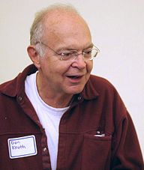
TeX
TeX is a typesetting system designed and mostly written by Donald Knuth and released in 1978. Within the typesetting system, its name is formatted as
Donald Ervin Knuth (born January 10, 1938) is an American computer scientist, mathematician, and Professor Emeritus at Stanford University.
He is the author of the multi-volume work The Art of Computer Programming. Knuth has been called the "father" of the analysis of algorithms.

Slide 56
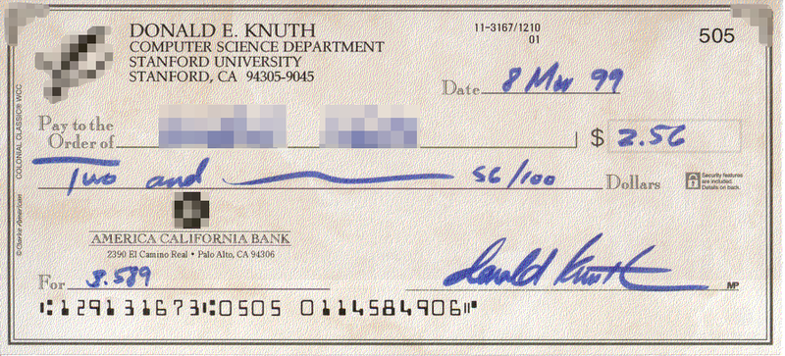
He used to pay a finder's fee of $2.56 for any typographical errors or mistakes discovered in his books, because "256 pennies is one hexadecimal dollar", and $0.32 for "valuable suggestions". According to an article in the Massachusetts Institute of Technology's Technology Review, these Knuth reward checks are "among computerdom's most prized trophies".

Slide 57
LaTeX
LaTeX is a document preparation system and document markup language.
It is the de facto standard for the communication and publication of scientific documents in many fields, including mathematics, physics, and computer science.
LaTeX uses the TeX typesetting program for formatting its output, and is itself written in the TeX macro language.

Slide 58
Software to Use LaTeX
Install MikTeX
Install Ghostscript
Install Adobe reader
Install WinEdt

Slide 59
SOOTHING ADVICE!
“They come into the university … knowing precisely who they are: successful and intelligent holders of well-earned qualifications. It is not long before they lose their initial confidence and begin to question their own self-image!” Does this describe you as a young, vibrant researcher a few months back? Well then, you should know that a Ph.D. is “determination and ability rather than brilliance”.
http://manchestersteps.wordpress.com/2011/01/24/book-review-how-to-get-a-phd/

